Slide 1



LORENZO SOLIGO
MATR . 2101057
COMPUTER SCIENCE BACHELOR’S THESIS
Explainable Machine Learning Through Large Language Models:
Analysis and Prompt Design
Exploring the complexity of machine learning algorithms, combining traditional XAI techniques with Large Language models to generate human-readable explanations.
SUPERVISOR: PROF. MICHELE SCQUIZZATO
TUTOR: GREGORIO PICCOLI (ZUCCHETTI S.P.A.)
PADUA JULY 2026

Slide 2
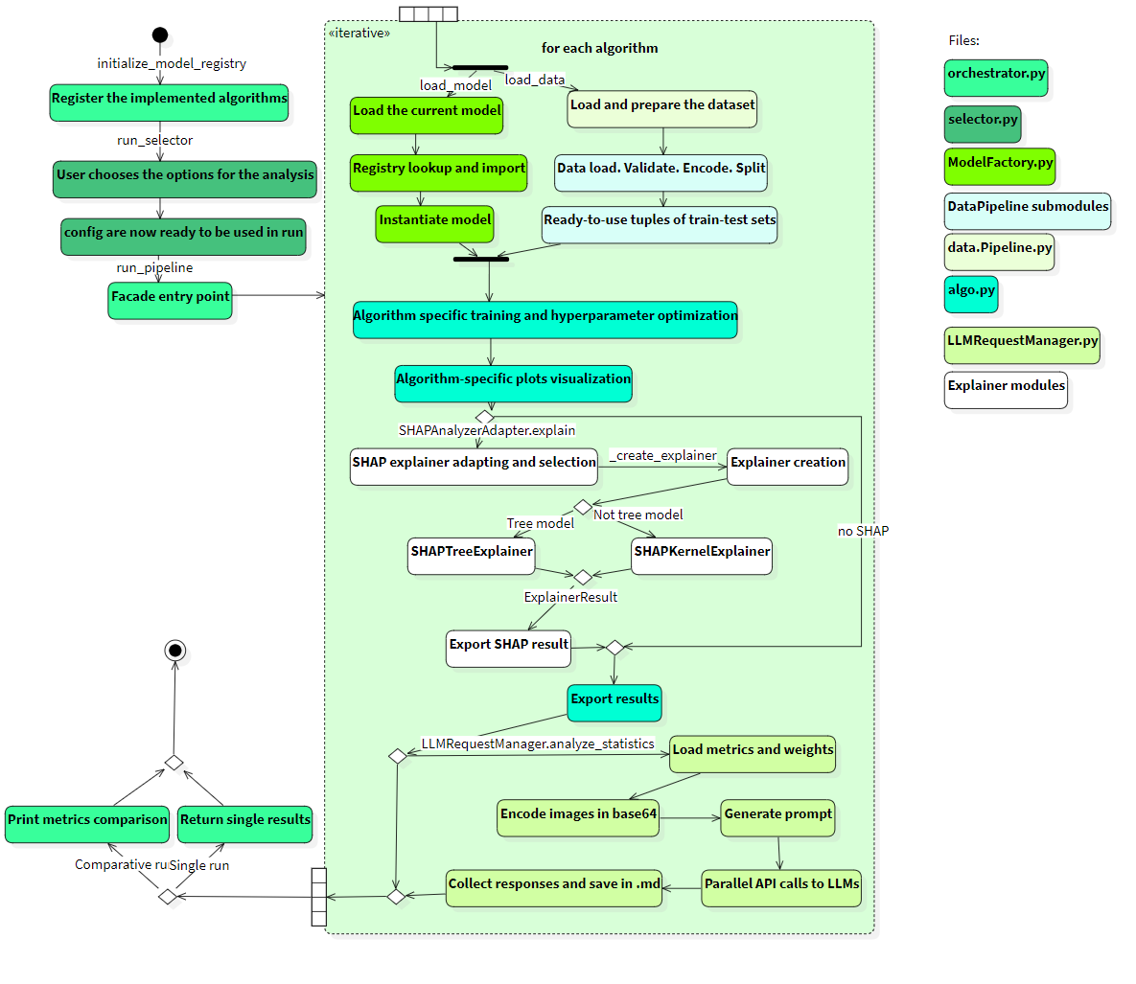
S 0 2 / 0 8
T H E C O N T E X T
№ 0 2 · THE EXPLAINABILITY GAP
Bridging the gap between high accuracy and human comprehension.
The XAI Dilemma: High-performing models (e.g., XGBoost, SVM) operate as "black boxes," while transparent models (e.g., Linear/Logistic Regression) often fall short on complex, non-linear patterns.
The Communication Gap: Business stakeholders struggle to interpret raw statistical outputs (such as SHAP values, mathematical coefficients, and ROC curves).
The Solution: An automated pipeline that trains predictive models, extracts local and global explanations via SHAP, and translates them into natural domain language using Large Language Models (LLMs).
LORENZO SOLIGO
ZUCCHETTI S.P.A.
PADUA JULY 2026

Slide 3
S 03 / 08
THE ORGANIZATION
№ 0 3 · INTERNSHIP ORGANIZATION
The internship was divided in two complementary section: the study of the algorithms and the development of the pipeline.
1.
The Algorithm analysis: The analysis was centered on the mathematical foundatioon of the models, the computational complexity, the internal representation and the data assumptions. Given this initial informations, the predictive performances and interpretablity limitaitions are descripted.
The Pipeline: The development of the pipeline and the integrgation of the models in the pipeline, focusing on the implementation
2.
LORENZO SOLIGO
ZUCCHETTI S.P.A.
PADUA JULY 2026

Slide 4
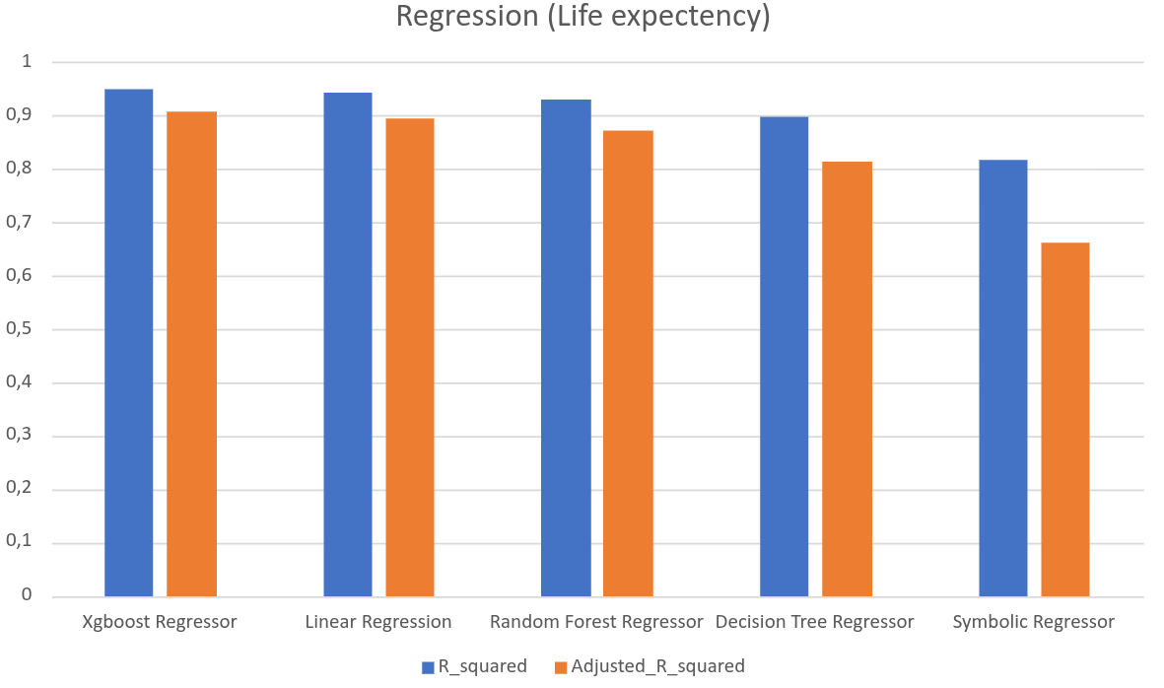
S 04 / 0 8
EVALUATION
№ 04 · ALGORITHMIC EVALUATION
Balancing Accuracy against
Explainer Costs.
ALGORITHM
CLASS. F1-SCORE
REGR. ADJ. R²
SHAP COST
SVM | 0.8909 | — | High
XGBoost | 0.8695 | 0.9089 | Low
Random Forest | 0.8245 | 0.8730 | Low
Linear/Log Reg. | 0.7667 | 0.8939 | Low
Decision Tree | 0.8060 | 0.8143 | Low
Symbolic Reg. | — | 0.6624 | Medium
Classification (Heart Disease Dataset): SVM achieved the highest F1-Score (0.8909), leveraging non-linear kernel transformations. It outperformed ensemble methods like XGBoost (0.8695) and Random Forest (0.8245).
Regression (Life Expectancy Dataset): XGBoost dominated the regression tasks with an adjusted R² score of 0.9089. Simple Linear Regression remained highly competitive (0.8939).
The Post-Hoc Computation Trade-off: Complex models like SVM require model-agnostic kernel perturbation explainer routines (Kernel-SHAP), which are highly expensive. Tree-based models (XGBoost/RF) leverage highly optimized Tree-SHAP.
LORENZO SOLIGO
ZUCCHETTI S.P.A.
PADUA JULY 2026

Slide 5
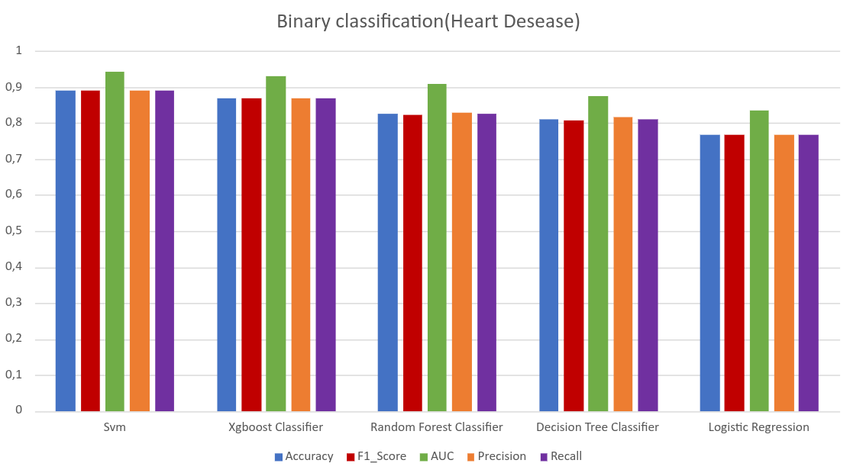
S 04 / 0 8
EVALUATION
№ 04 · ALGORITHMIC EVALUATION
Balancing Accuracy against
Explainer Costs.
Classification (Heart Disease Dataset): SVM achieved the highest F1-Score (0.8909), leveraging non-linear kernel transformations. It outperformed ensemble methods like XGBoost (0.8695) and Random Forest (0.8245).
Regression (Life Expectancy Dataset): XGBoost dominated the regression tasks with an adjusted R² score of 0.9089. Simple Linear Regression remained highly competitive (0.8939).
The Post-Hoc Computation Trade-off: Complex models like SVM require model-agnostic kernel perturbation explainer routines (Kernel-SHAP), which are highly expensive. Tree-based models (XGBoost/RF) leverage highly optimized Tree-SHAP.
LORENZO SOLIGO
ZUCCHETTI S.P.A.
PADUA JULY 2026

Slide 6
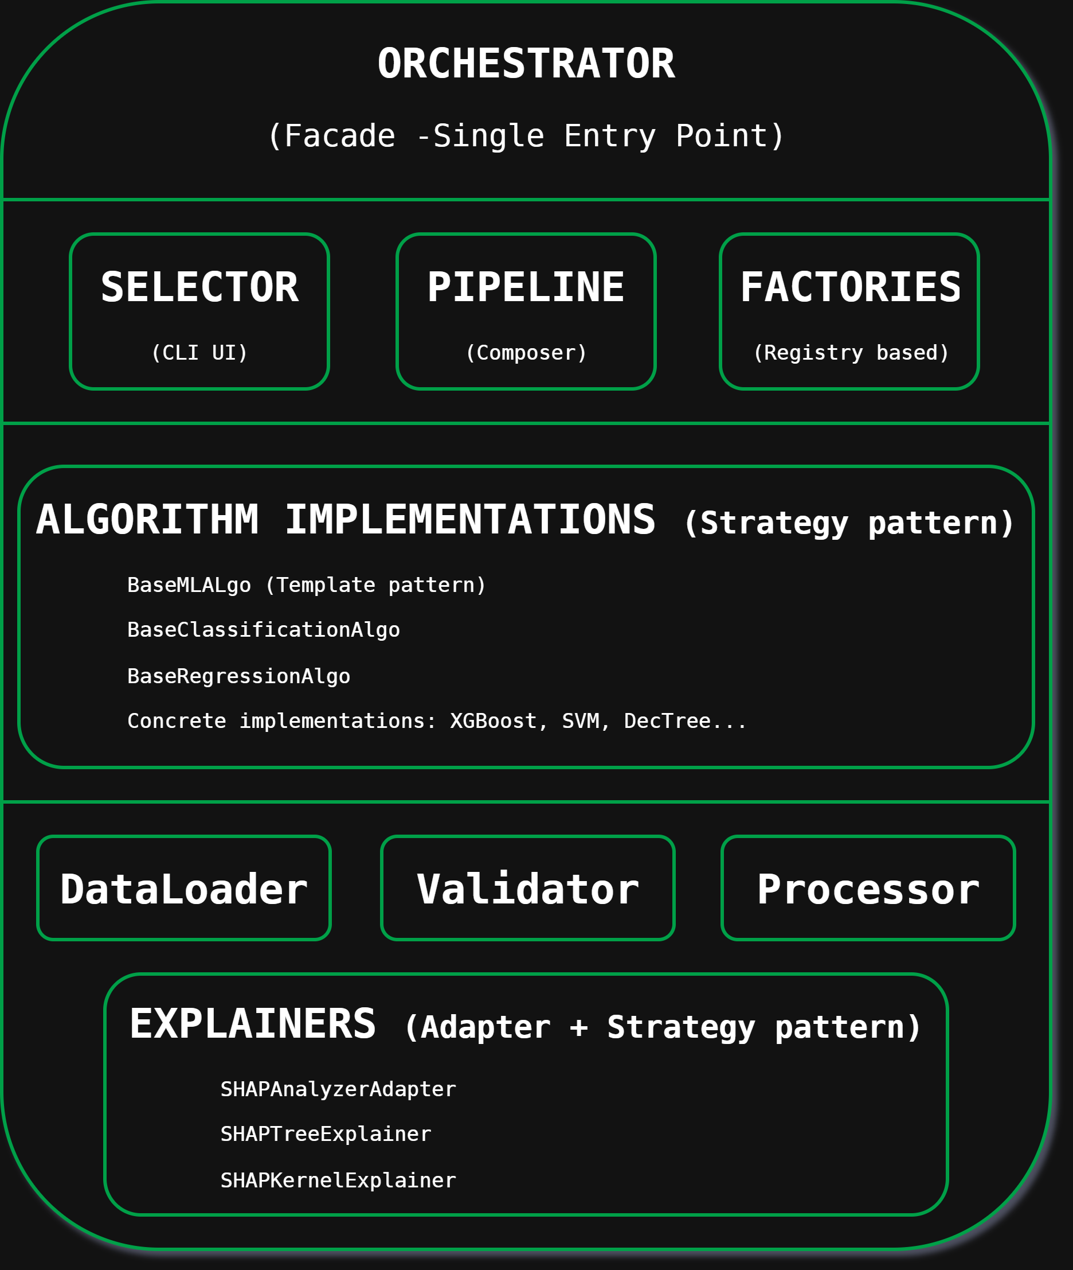

S 05 / 08
ARCHITECTURE
№ 0 5 · M O D U L A R P I P E L I N E D E S I G N
MODULE
DEPENDENCIES
&
LAYERING
Layered architecture for decoupled modules.
The system employs a strict 5-layer separation of concerns to maximize modularity and enable parallel development:
Presentation Layer: Interactive Streamlit GUI dashboards.
Orchestration Layer: Manages sequential flow via the Facade pattern.
Data Layer: Independent loader, validator, and preprocessing method classes.
Model/XAI Layer: Model wrappers and explainer strategies (SHAP).
LLM Layer: Prompt builder and asynchronous API request dispatcher.
LORENZO SOLIGO
ZUCCHETTI S.P.A.
PADUA JULY 2026

Slide 7
S 05 / 08
ARCHITECTURE
№ 0 5 · M O D U L A R P I P E L I N E D E S I G N
MODULE
DEPENDENCIES
&
LAYERING
Layered architecture for decoupled modules.
The system employs a strict 5-layer separation of concerns to maximize modularity and enable parallel development:
Presentation Layer: Interactive Streamlit GUI dashboards.
Orchestration Layer: Manages sequential flow via the Facade pattern.
Data Layer: Independent loader, validator, and preprocessing method classes.
Model/XAI Layer: Model wrappers and explainer strategies (SHAP).
LLM Layer: Prompt builder and asynchronous API request dispatcher.
LORENZO SOLIGO
ZUCCHETTI S.P.A.
PADUA JULY 2026

Slide 8
S 05 / 08
DESIGN PATTERN
№ 05 · APPLIED DESIGN PATTERNS
Enabling extensibility through Object-Oriented Design Patterns.
Strategy Pattern
Template Method
Factory & Registry
Swaps model algorithms and explainer strategies dynamically under a common `baseMLAlgo` interface.
Enforces the pipeline steps and data preprocessing execution sequence, letting subclasses define specifics.
Initializes ML models dynamically, storing concrete classes in a centralized registry
with Value Objects.
Adapter Pattern
Facade Pattern
Value Objects
Adapts different scikit-learn and XGBoost model interfaces to meet the uniform input demands of the SHAP library.
Exposes a simplified `Orchestrator.run_pipeline()` entry point, hiding complex subsystem details from the GUI.
Ensures type safety and data validation for registry items, parameters, and results across pipeline layers.
LORENZO SOLIGO
ZUCCHETTI S.P.A.
PADUA JULY 2026

Slide 9
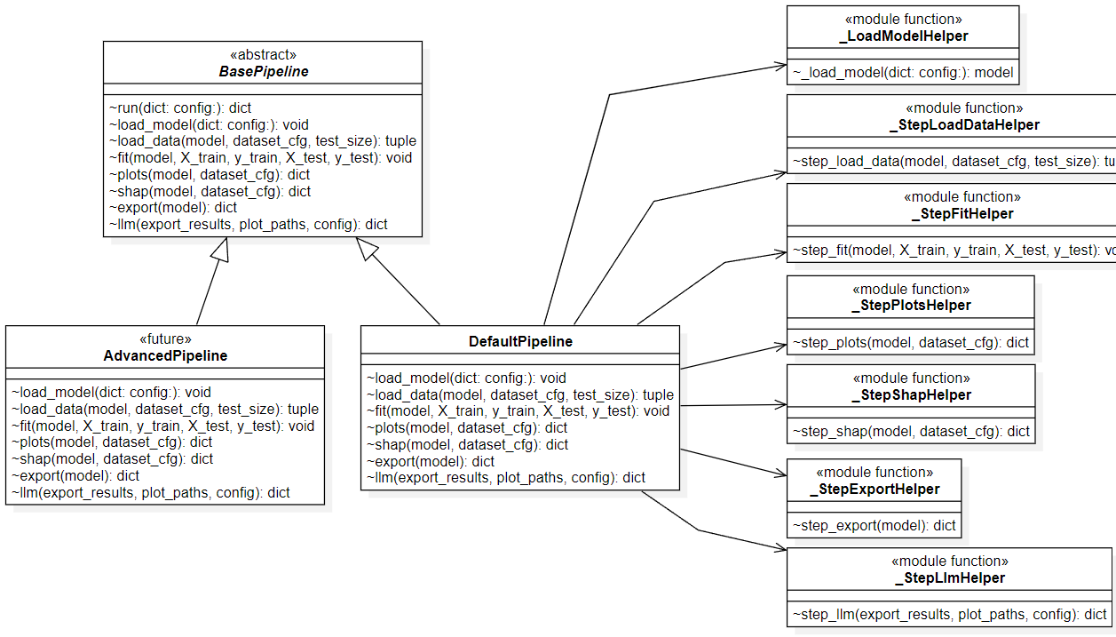
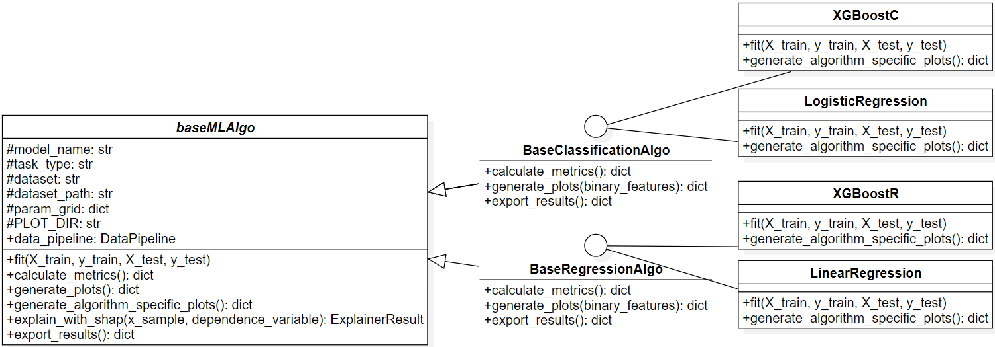
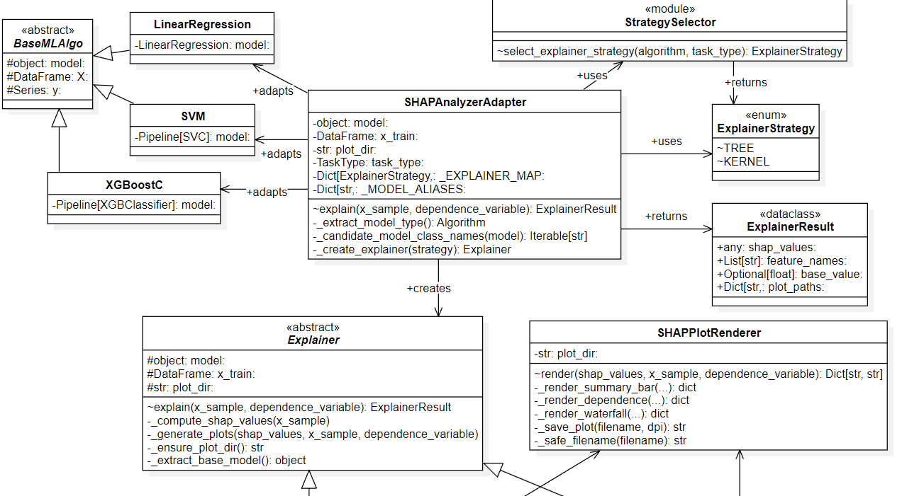
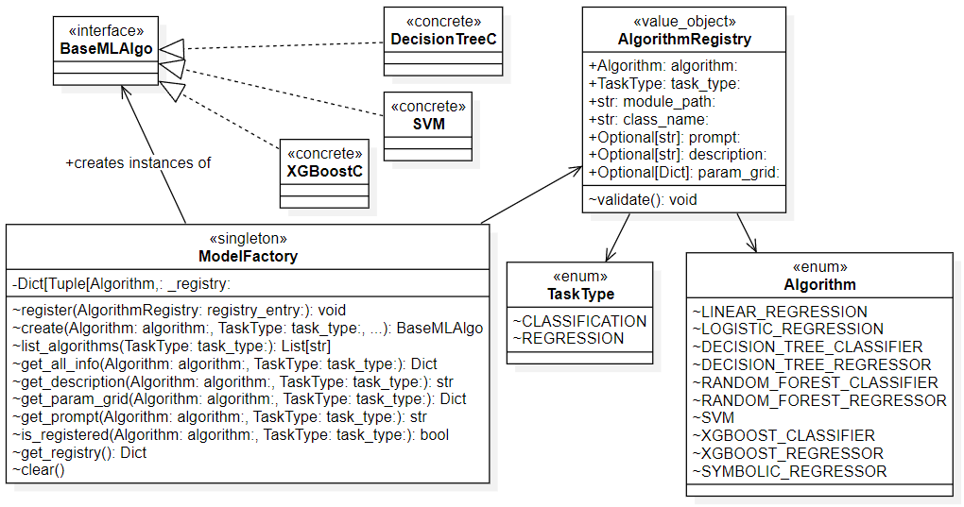
S 05 / 08
Template Method
DESIGN PATTERN
Strategy Pattern
Adapter
Pattern
Factory &
Registry
LORENZO SOLIGO
ZUCCHETTI S.P.A.
PADUA JULY 2026

Slide 10
S 06 / 08
SOLID
№ 06 · SOLID CODE COMPLIANCE
Enforcing clean architecture for future scalability.
Adding a New Algorithm
Single Responsibility (SRP): Preprocessing is divided into dedicated functional units: `Loader`, `Validator`,
`Processor`, and `DataSplitter`.
1. Create a new class inheriting from baseMLAlgo .
SOL ID
2. Register the class in registryInitializer.py .
3. Add explainer hooks inside Explainer.py .
Open/Closed (OCP) & Liskov Substitution (LSP): High-level orchestration depends entirely on abstract base classes. Adding a new estimator requires zero modifications to the core orchestration code.
ORCHESTRATOR CODE REMAINS COMPLETELY UNTOUCHED
Dependency Inversion (DIP): Orchestrator references abstractions (`baseMLAlgo`), decoupling it from specific machine learning models.
LORENZO SOLIGO
ZUCCHETTI S.P.A.
PADUA JULY 2026

Slide 11
S 07 / 08
LLM LAYER
№ 0 7 · P R O M P T E N G I N E E R I N G R U L E S
Constraining LLM translations for high fidelity.
STRUCTURED PROMPT WRAPPER
# CONTEXT
Algorithmic Model: {algo_name} Dataset Scope: {dataset_desc} User Request: {user_prompt}
To guarantee explainability quality and minimize hallucinations, prompt templates enforce strict constraints:
# NUMERICAL METRICS
Metrics: {raw_metrics}
Coefficients: {raw_coefficients}
Simplicity: Limit narrative to 3-5 primary feature impacts.
Fidelity: Translate stats into natural business logic (avoid complex math equations).
# CORE EXPLAINABILITY RULES
Restrict focus to the top 3- 5 features.
Ground all claims in the business domain.
Compare outputs contrastively.
Flag any anomalies in data vs. expectations.
Contrastive: Explain predictions against alternatives (why class A vs. B).
Anomalies: Control LLM temperature to flag raw data discrepancies.
Multimodal Grounding: Encoded plots (residuals, SHAP summary plots) are sent to Vision LLMs. The model compares visual graphs with mathematical metrics to validate model fit.
LORENZO SOLIGO
ZUCCHETTI S.P.A.
PADUA JULY 2026

Slide 12
S 08 / 08
CONCLUSIONS
№ 08 · RESULTS AND ASSESSMENTS
Functional achievements & core constraints.
Achieved Results:
Project Limitations:
100% functional requirements met (dataset/algorithm selection, GUI, execution log).
Vision LLMs struggle to read exact values from dense scatter plots.
Successfully bridged the gap between complex ML outputs and business users.
High latency due to sequential external API calls (LLM + model training).
Robust, scalable backend ready for production extensions.
LORENZO SOLIGO
ZUCCHETTI S.P.A.
PADUA JULY 2026

Slide 13
S 08 / 08
CONCLUSIONS
№ 08 · IMPROVEMENTS
Future improvements.
Unsupervised Support:
Extend explainability strategies to clustering and anomaly detection tasks.
Parallel Dispatch:
Implement asynchronous multi-agent API calls to minimize execution time.
Coordinate Grounding:
Pass raw coordinate matrices along with visual plots to improve Vision LLM accuracy.
LORENZO SOLIGO
ZUCCHETTI S.P.A.
PADUA JULY 2026

